Slide 1

West Norriton Township Ready for 100 Initiative
Villanova University
Brandon Simons, Mohamed Abaas, Jessica Vairo, Clay Reilly, Heather Hill, Mary Spillane
May 10th , 2021

Slide 2
Agenda
Recap - Goals
Methodology/Audit
HVAC
Envelope
Lighting
Equipment
Recommendations
GHG Update
Council Input/Questions
Notes:
Brandon

Slide 3



West Norriton Township’s Ready For 100% Resolution
100% renewably sourced electricity
by 2035
100% clean, renewable energy for heating system and transportation equipment
by 2050
100% renewable energy sources
for township vehicle fleet (where feasible)
by 2030
CLEAN, EFFICIENT, RESILIENT, AFFORDABLE, EQUITABLE
Notes:
jess

Slide 4







Methodology
Annual Energy Consumption
Energy Star Portfolio Manger
Greenhouse Gases & Carbon Footprint
Baseline
Identify
Vehicles and Equipment Predominant Energy Producers
Potential Solutions – Electrification and Energy Efficiency Rebates and Incentives Building Audit Electricity Purchasing and Generation Options
Analyze
Recommend
Cost – Benefit – Environment Analysis
Final Recommendations
Notes:
Jess

Slide 5
HVAC Summary – Carrier HVAC Units
Current Carrier natural gas furnace/air conditioners 16-22 years old
Highly likely that units will fail at higher rate over next 1-5 years.
Recommend Township develop capital plan for phased replacement based on available capital
Dowd Mechanical requested to provide quotes for 80% and 90% efficiency natural gas furnace units plus heat pumps.
If Natural gas furnaces recommend the combination NG furnace + heat pump be selected and recommend 90% efficiency units
New units expected to last 15 years
Natural gas prices expected to increase
“80% efficiency units” actually < 80% (seasonal inefficiencies in how furnace and air conditioner operates)

Slide 6
HVAC Zones, WNT Admin Building – Rooftop Units (RTU) & Temperature Control Map
Trouble Zones
TC
Thermostats (Temperature Control, TC) locations on map = actual installed locations in Admin Bldg’s HVAC zones
RTU-3/HAC-14, Office, Bathroom, Corridor, Plan Room
SP=74, Act=74
RTU-13/HAC-13, Storage
TC
TC
TC
SP=69, Act=69
Sanyo AC,
EMOC
RTU-12/HAC-12, Storage
SP=72, Act=73
RTU-5/Trane, Woman’s Restroom, Men’s Restroom, Locker Room, Conference Room, Records, Processing, Cell#1, Cell#2, Roll, Call, Sgt’s Office, Dark Room, TSU, Locker Rooms, Lunch Room, General Area
RTU-7/HAC-10, Detective Area, Office, Interview Areas
RTU-7/HAC-10, Detective Area, Office, Interview Areas
TC
TC
TC
SP=67, Act=68
TC
SP=70, Act=70
SP=68, Act=70
SP=70, Act=70
RTU-1/HAC-15, Office, Files, Reception, Conference Room, Office
Corridor
TC
Corridor
SP=71, Act=70
Corridor
RTU-4/HAC-7, Corridor, Lounge, Lunch, Reception, Restrooms, Parks and Recreation Offices,
RTU-9/HAC-1, Chief’s Office,
Police Admin Area
RTU-8/HAC-2, Deputy Chief, Restrooms, Lounge, Lunch Area, Conference Room, File Room, Weapons Storage, Evidence Check-In/Processing, , Caucus Room
RTU-6/HAC-5, Back Half of Commissioner Meeting
RTU-5/HAC-6, Back Half of Commissioner Meeting
TC
TC
SP=55, Act=72
TC
SP=71, Act=71
TC
SP=75, Act=73
No RTUs, Local Heat Only, Supply Dispatch, Restroom, Waiting Area
SP=70, Act=70
SP=70, Act=70
RTU-2/HAC-8, Offices, Waiting room, Corridor
TC
Front of Building

Slide 7
HVAC Zones
Heating is combination of Natural Gas rooftop furnaces/forced hot air system, baseboard electric heaters.
Balanced/correct air flow critical to maintain temperature control and reduce cost of baseboard electricity heating. Air balancing controlled by manually adjusted dampers.
Trouble Spots
Reception Area: Actual temperature = 72 °F, setpoint = 55 °F. Parks and Recreations likely never heated
Chief’s Office, Police Area: Poor/No temperature control/air flow. Limit number of return vents or return vents in conference rooms. Balanced air supply required. Recommend rebalancing building or minimum RTU-4, RTU-5, RTU-8, RTU-9 zones.
Recommend relocation of RTU-5 and RTU-9 thermostats so centrally located (currently - one in corridor, one outside woman’s bathroom, both in extreme areas).
Local Fan control units and Air Rebalancing: Rebalancing will also enhance building occupant’s understanding on use of local fan controls.

Slide 8
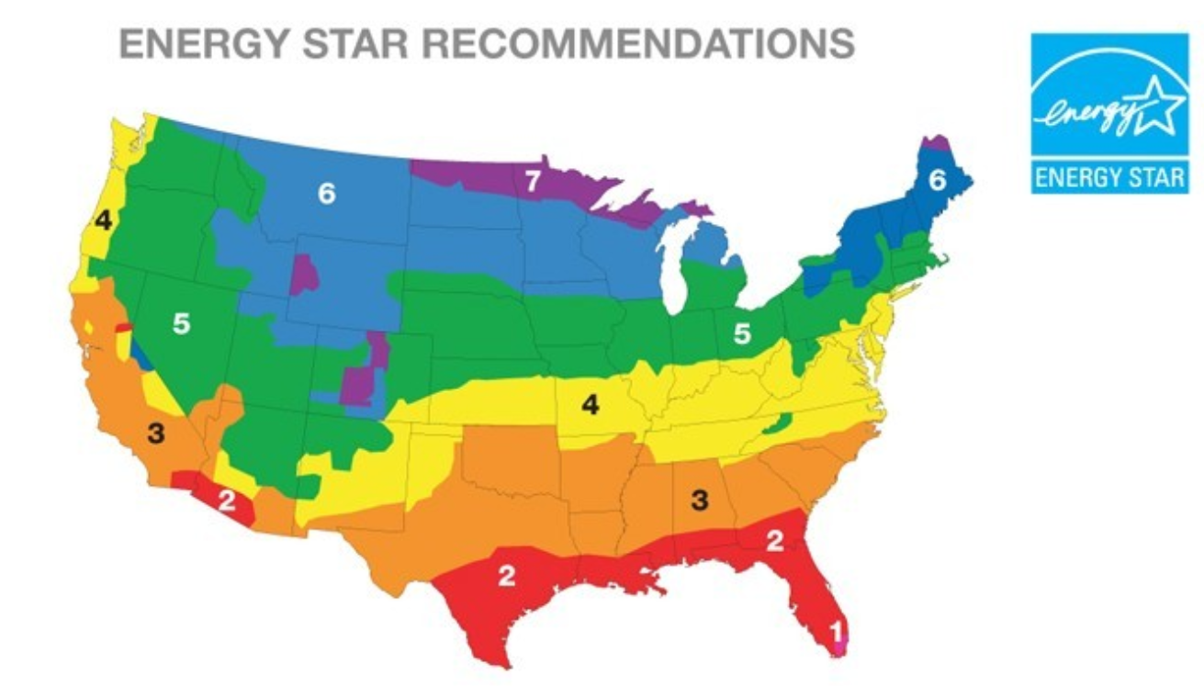
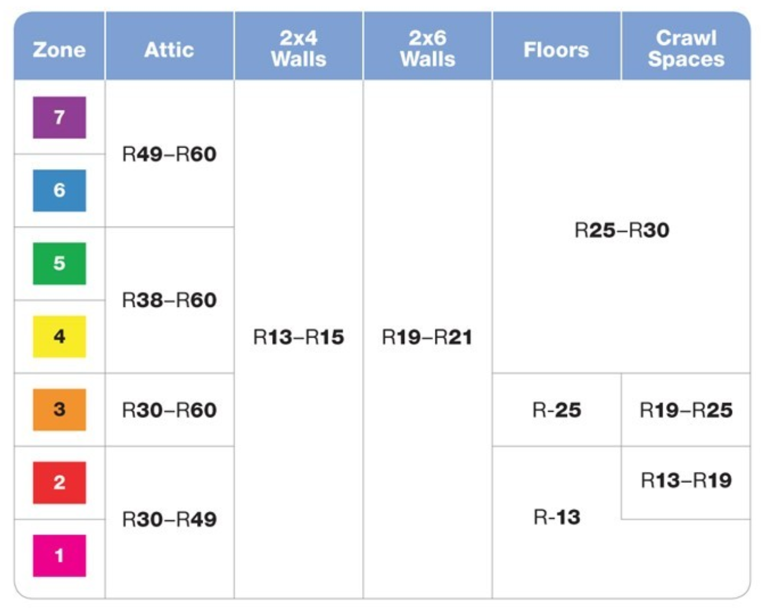
Building Envelope
Insulation, per original engineering plans:
Exterior walls: 3 5/8 in. metal studs; Insulation: 3 ½ in. foil face, FS-25, R-11 batt (3.5 in. thick).
Roof: 6 ¼ in., FS-25, R-19 (6.25 in. thick) batt insulation blankets.
Floor: None listed in 1988 engineering report. Floor may be ceramic tile installed over standard subfloor.
Inspection of basement mechanical space allowed partial inspection of `Admin building floor and floor appeared to be uninsulated.
Flame Spread 25 (FS-25) fiberglass insulation: light density, flexible batt insulation with factory-applied facing.
Has an assured low flame spread and can be used in walls, floors and ceilings where a low flame spread vapor retarder is required
Results/Recommendations:

Slide 9
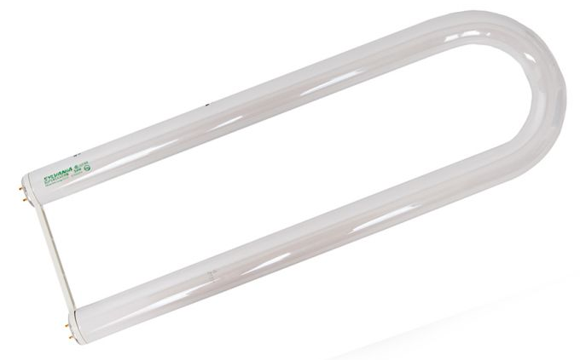
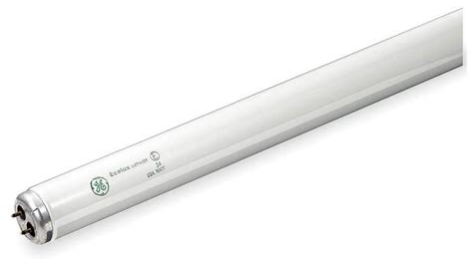


Lighting - Overview
 | Police Wing | Rest of Building | Cost
Hours of Use | 24 hours 7 days per week | 8 hours 5 days per week
T8 Fluorescents | 189 | 247 | $2.88
T12 U Bulb Fluorescents | 4 | 282 | $6.15
Police Wing
Mostly T8s 34W & 28W
Fluorescent
Rating: 15,000 hours
Rest of Building
Mostly U T12s 40W
Fluorescent
Rating 18,000 hours

Slide 10


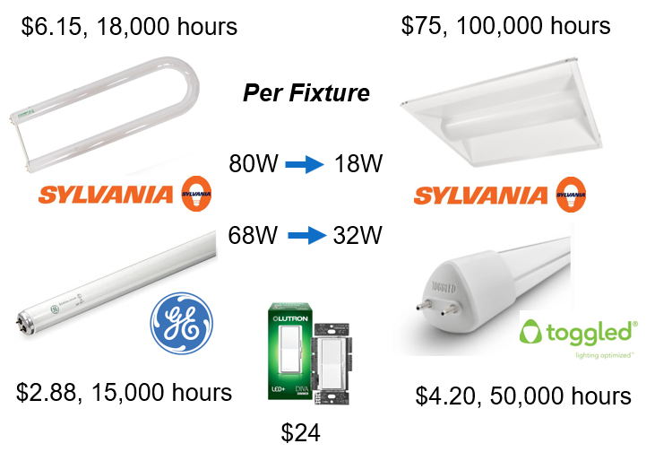
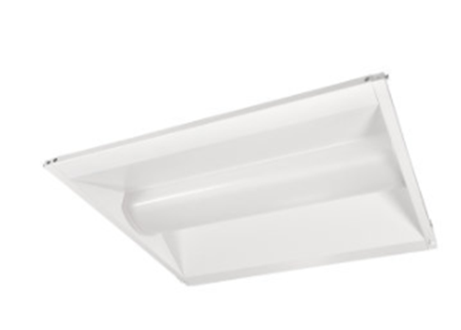
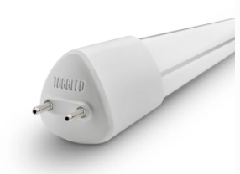
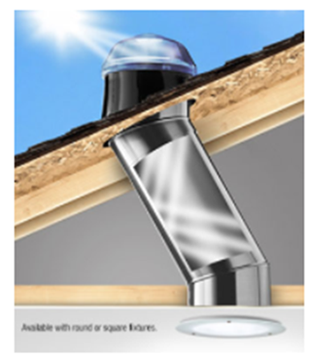


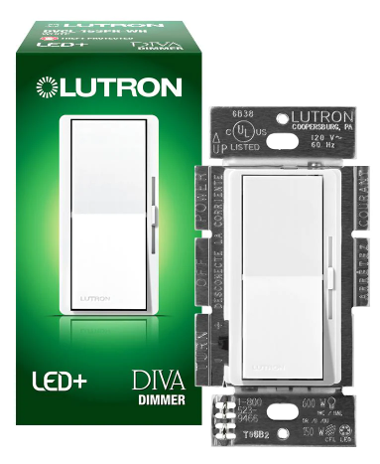

Lighting – Recommendations
1. Replace T12 U bulb fixtures to LED with a retrofit kit
2. Rewire existing T8 fixtures to adopt linear TLEDs and use 16-Watt dimmable LED replacements.
3. Replace all existing switches to dimmer switches. 20% reduction
4. Explore daylighting options for appropriate rooms - Solatube.

Slide 11



PECO / Rebates, Savings, & Consulting
TLEDs (DLC certified): $5
$4.20 per TLED, 50,000-hour rating
LED Retrofit Fixtures (DLC certified): $10
$75 per kit,100,000-hour rating
Dimmer Switches: $5
$24 per switch
Fixture Removal: $0.25 /W of fixture
$12 per U bulb fixture
Design Light Consortium Standard
Estimated Savings
$2,500 in electricity annually
$300 in replacements annually
PECO Smart Ideas Application
Online Application Center
Equipment Entry/ Worksheet
Lighting Photos
Rebate Tracking and Saving Estimates
Approval
Installation
Rebate Payment
New Rebate Cycle on June 1st, 2021

Slide 12
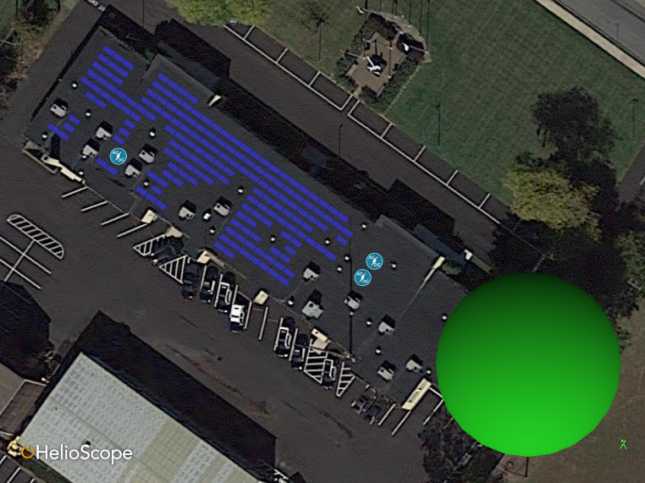
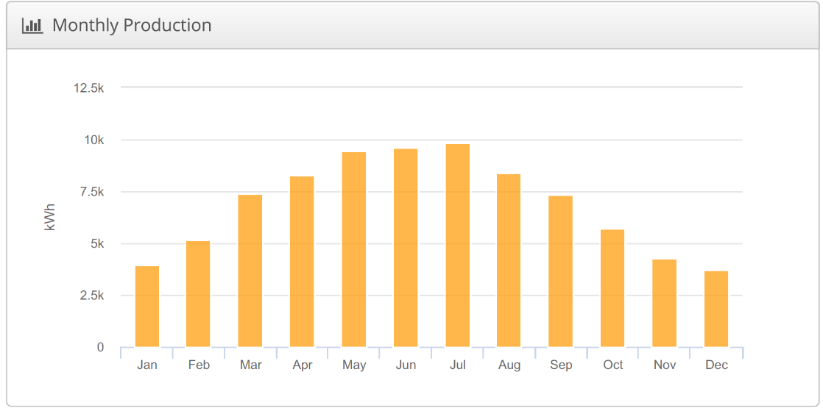
Solar Rooftop - Technical
System Size | 63.3 KW
Annual Production | 83.22 MWh
Energy off-set | 38%

Slide 13
Solar - Budget
Savings Over 25 years | $119,129.42
IRR | 0%
ROI | ($641.86)
NPV Discount Rate | 5%
Pay Back (Years) | 25.13
NPV after 25 years | ($54,275.75)
Product | Description | Unit Price | Quantity | Total
Sunny Tripower 240000TL-US (SMA) | Inverter | $4,500.00 | 3 | $13,500.00
Hanwha, Q.Peak L-G4.2 370 | Module | $237.00 | 171 | $40,527.00
Everest Cross Rail System | Support |  | 171 | $0.00
Combiner Box | Combiner |  | 6 | $0.00
#12 CU | Copper Wiring | $0.24 | 1367 | $328.08
#10 CU | Copper wiring | $0.17 | 557.9 | $94.84
Total |  |  |  | $54,449.92
Item | System Size (kWdc) | Material Rate ($ / Watt) | Material Total | Labor ($ / Watt) | Prevailing Wage Adjustment | Total
PV Equipment ($/W) | 63.3 | 0.86 | $54,449.92 | 0.45 |  | $54,478.41
PV Conduit, Conductors and Gear ($/W) | 63.3 | 0.5 | $31,650.00 | 0.6 |  | $31,687.98
Electrical OH&P (15%) | 15% | - | - | - | 30% | $16,802.45
GC OH&P (15%) | 15% | - | - | - | 30% | $16,802.45
Total Cost |  |  |  | $119,771.3
$/kW |  |  |  | $434.3

Slide 14
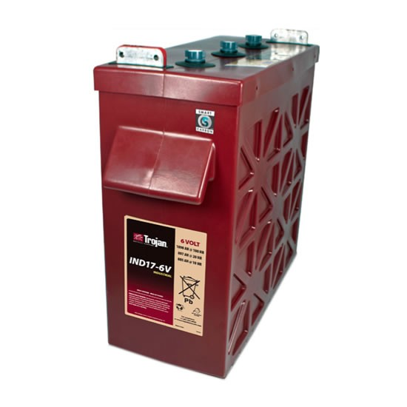
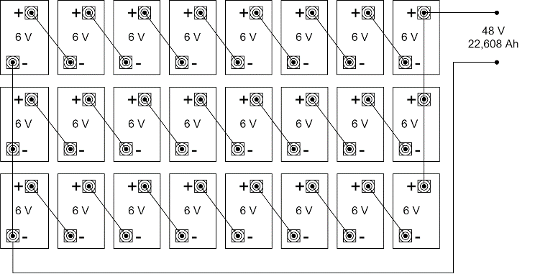
Battery Backup
Sizing | 24 Batteries (3 Rows X 8 Units)
Capacity and Duration | 2 days of charge (22,608 Ah @ 48V)
Unit Cost | $1,098.31
Total Cost | $26,352.00

Slide 15


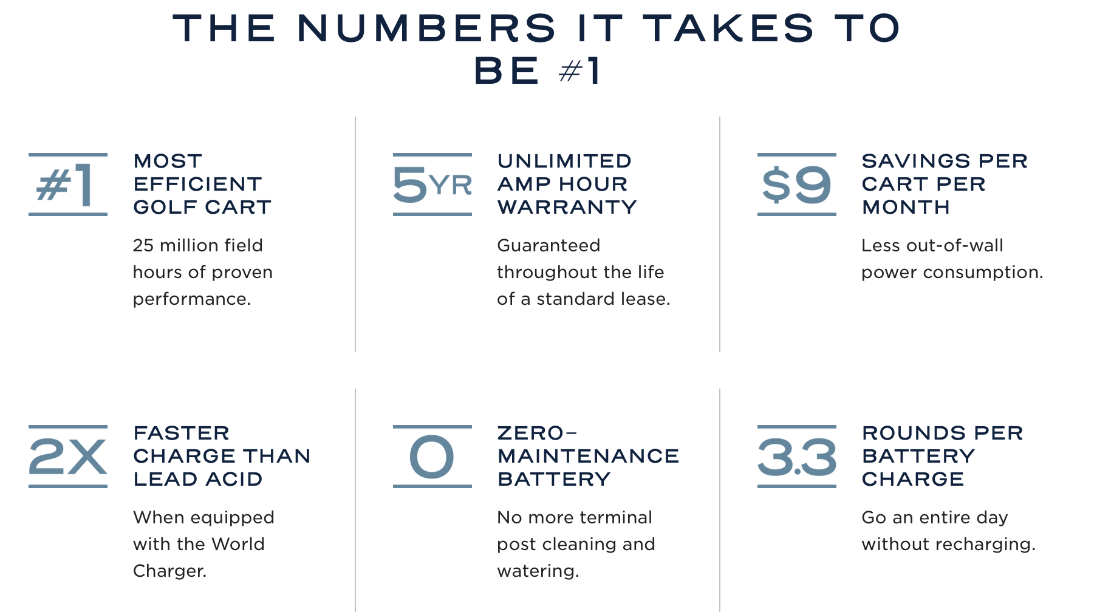
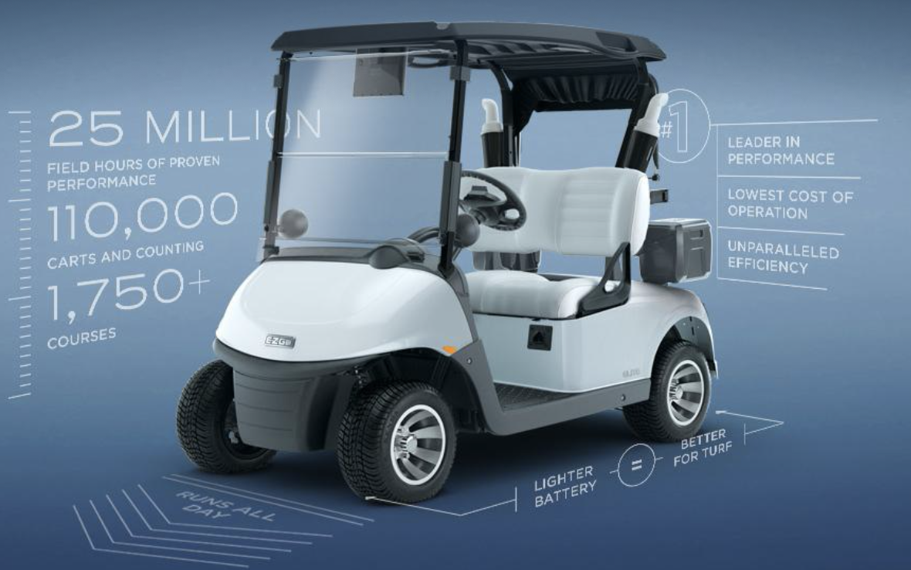
Equipment – Golf Carts

Slide 16
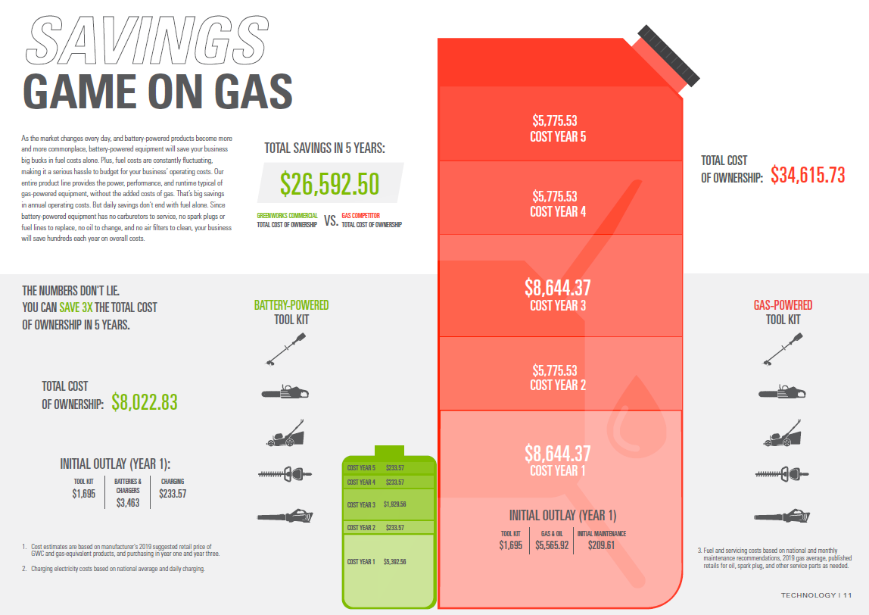
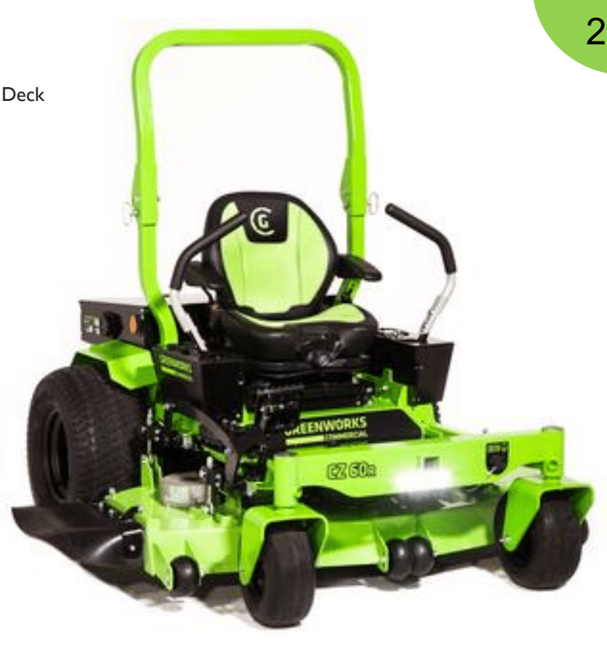
Equipment – Lawn Care

Slide 17
Police Department |  | Vehicle Type | vehicle ID | MPG | Year | Age | Annual Mileage | MPG | Mileage
2018 Chevy Traverse |  | Mid-Size SUV | 62-1 | 16.2 | 2018 | 3 | 5454 | 16.2 | 14740
2018 Chevy Traverse |  | Mid-Size SUV | 62-2 | 18.1 | 2018 | 3 | 5810 | 18.1 | 30383
2016 Ford Expedition |  | SUV | 62-10 | 8.1 | 2016 | 5 | 2273 | 8.1 | 70582
2019 Dodge Charger |  | Passenger Car | 62-11 | 7.7 | 2019 | 2 | 21489 | 7.7 | 34473
2017 Chevy Tahoe |  | SUV | 62-12 | 8.2 | 2017 | 4 | 10655 | 8.2 | 48683
2017 Dodge Charger |  | Passenger Car | 62-15 | 7.5 | 2017 | 4 | 11461 | 7.5 | 37146
2012 Chevy Tahoe |  | SUV | 62-16 | 8.3 | 2012 | 9 | 24285 | 8.3 | 40189
2018 Chevy Tahoe |  | SUV | 62-14 | 7.4 | 2018 | 3 | 15942 | 7.4 | 47901
2020 Dodge Charger |  | Passenger Car | 62-18 | 7.5 | 2020 | 1 | 11241 | 7.5 | 121120
2019 Chevy Silverado |  | PickUp Truck | 62-20 | 8.3 | 2019 | 2 | 23696 | 8.3 | 15831
2009 Ford Fusion |  | Passenger Car | 62-31 | 15.9 | 2009 | 12 | 4614 | 15.9 | 74504
2018 Chevy Tahoe |  | SUV | 62-17 | 12.4 | 2018 | 3 | 11432 | 12.4 | 38791
2014 Dodge Charger |  | Passenger Car | 62-33 | 14.9 | 2014 | 7 | 4373 | 14.9 | 53695
Public Works Dept
2013 International |  | Heavy Duty, On Road Truck | PW-23 | 3.4 | 2013 | 8 | 219 | 3.4 | 20988
2015 Chevy Silverado |  | PickUp Truck | PW-24 | 8.1 | 2015 | 6 | 6249 | 8.1 | 44727
2015 Ford Dump Trk |  | Heavy Duty, On Road Truck | PW-25 | 2.8 | 2015 | 6 | 1254 | 2.8 | 13422
2014 Chevy Silverado |  | PickUp Truck | PW-28 | 9.5 | 2014 | 7 | 1705 | 9.5 | 28830
2014 Chevy Silverado |  | PickUp Truck | PW-29 | 9.3 | 2014 | 7 | 5683 | 9.3 | 65674
2020 Chevy Silverado |  | PickUp Truck | PW-32 | 18.3 | 2020 | 1 | 5708 | 18.3 | 3752
2013 Chevy Silverado |  | PickUp Truck | PW-34 | 9.7 | 2013 | 8 | 4728 | 9.7 | 55243
2016 GMC Sierra |  | PickUp Truck | PW-27 | 8.5 | 2016 | 5 | 3209 | 8.5 | 16595
2013 International |  | Heavy Duty, On Road Truck | PW-21 | 4.9 | 2013 | 8 | 387 | 4.9 | 19196
 |  | EV Candidate
 |  | HEV Candidate
HEV or PHEV
Low use
EV

Slide 18
Hybrid Vehicle Cost Analysis
FORD HYBRID VEHICLE - COST PER VEHICLE PATROL FLEET
Estimated Fuel Efficiency - Miles Per Gallon | 24
Estimated Miles Per Year | 10269
Estimated Idle Time Per Year (IN HOURS) | 1460
Estimated Price Per Gallon | $2.69
Estimated Yearly Sub-Total cost for miles driven per year | $1,151.00
Estimated Yearly Sub-Total cost for time idled per year | $801.19
Estimated Gallons USED Per Year - DRIVING | 427.88
Estimated Gallons USED Per Year - IDELING (based on .204 gallons per hour) | 297.84
Estimated Gallons USED Per Year - TOTAL | 725.72
GRAND TOTAL COST PER YEAR - FUEL USED | $2,250.03
NON HYBRID VEHICLE - COST PER VEHICLE PATROL FLEET
Estimated Fuel Efficiency - Miles Per Gallon | 11.3
Estimated Miles Per Year | 10269
Estimated Idle Time Per Year (IN HOURS) | 1460
Estimated Price Per Gallon | $2.69
Estimated Yearly Sub-Total cost for miles driven per year | $2,444.56
Estimated Yearly Sub-Total cost for time idled per year | $1,826.24
Estimated Gallons USED Per Year - DRIVING | 908.76
Estimated Gallons USED Per Year - IDELING (based on .465 gallons per hour) | 678.9
Estimated Gallons USED Per Year - TOTAL | 1587.66
GRAND TOTAL COST PER YEAR - FUEL USED | $4,270.81
FUEL COST FLEET WIDE (18)
Hybrid Units | $40,500.48
Non-Hybrid Units | $76,874.50
Fleetwide Savings Per Year
Fuel | $36,374.01
CO2 (lbs) | 17238.8
Initial Cost of Vehicle
2021 Chevy Traverse | $30,000
2021 Ford Interceptor | $40,000
5 year ROI
Notes:
Overall the recommendations are to stop purchasing any new solely powered gas vehicles unless deemed completely necessary, and instead replace any vehicles going out of commission with HEV or EV vehicles. From talking with the police department it seems like they are more comfortable with trying out HEVS for now, but it is recommended to also try out EVs in the coming years for lower use vehicles.

Slide 19
Final Recommendations
Short-term (1-2 yrs)
Develop capital plan for replacement of Admin Bldg HVAC units (e.g. NG Furnace/Heat Pump)
Rebalance Admin Bldg HVAC air flow/relocate two thermostats
Repairs/Insulate - Repair hole in basement ceiling, insulate hot water supply line from boiler, repair weather stripping in front doors, insulate floor, insulate roof.
Stop purchasing any new solely powered gas vehicles unless deemed completely necessary, and instead replace any vehicles going out of commission with HEV
Replace all fluorescent T8 bulbs with TLED counterparts and install dimmer switches
Medium-term (3-5 yrs)
Replace rooftop HVAC units
Recommend: E-Z-Go Elite Lithium golf carts for performance, efficiency & cost savings
Consider purchasing EVs for lower use vehicles
Replace T12 U-bulb fixtures with dimmable LED retrofit kits
Replace smaller, handheld lawn care equipment (blowers, chainsaws, trimmers)
Long-term (6-10 yrs)
Transition entire vehicle fleet to HEVs and EVs
Consider daylighting options for larger rooms
Consider replacing larger lawn care mowers (tees, greens, fairways) and attachments (sand traps and rough attachments)
Re-evaluate solar and battery back up potential

Slide 20
Energy Greenhouse Gas Profile
Annual Emissions
746.8 Mt CO2e
Annual Emissions
193.8 Mt CO2e
Base Case
Projected

Slide 21
Questions?

Slide 22
Background

Slide 23
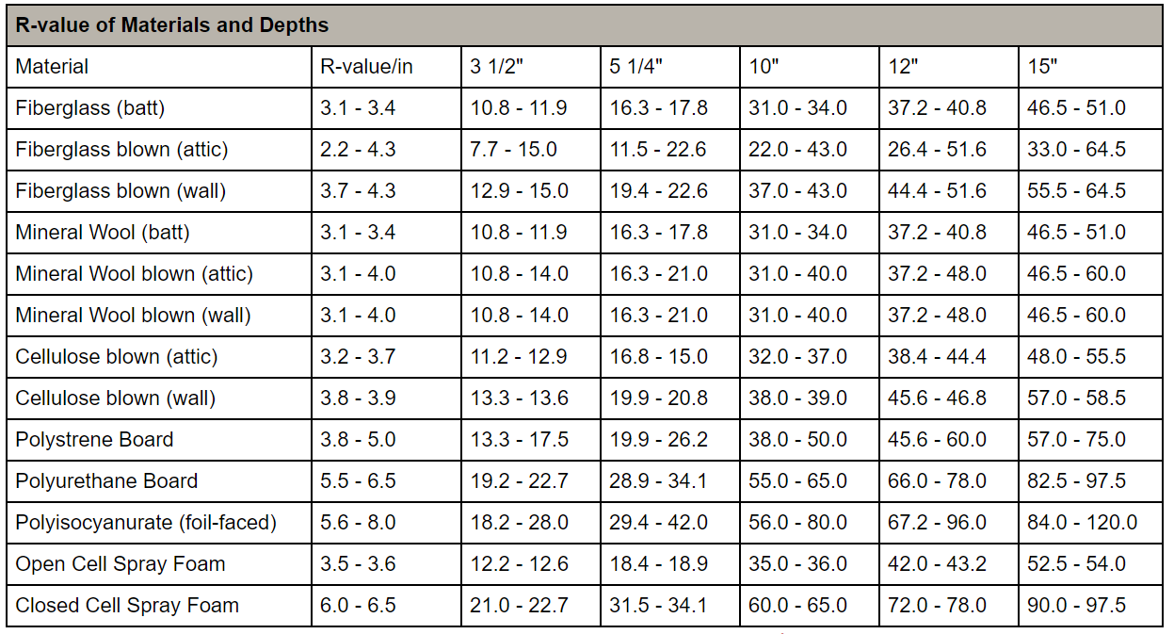
Insulation R values

